Slide 1

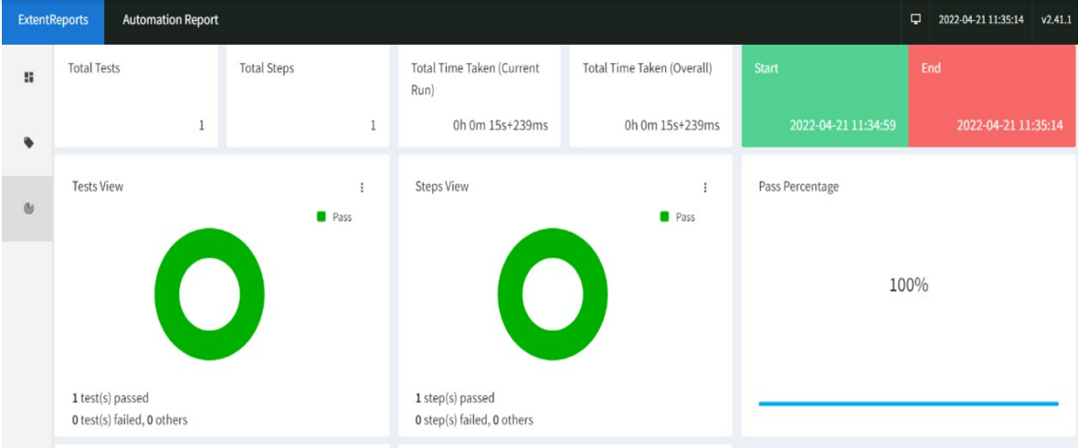
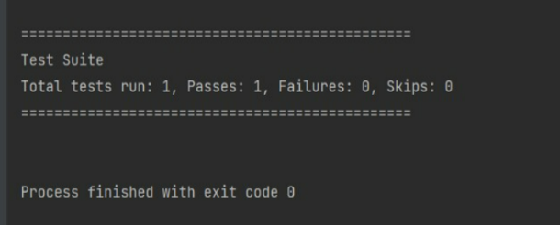
AUTOMATION TESTING OF AN ONLINE WEBSITE USING SELENIUM
Department of Computer Science & Engineering
School of Computing
1156CS701 – MAJOR PROJECT
WINTER SEMESTER 21-22
ABSTRACT
INTRODUCTION
RESULTS
STANDARDS AND POLICIES
Manual testing is frequently undertaken process prior to the release of software as part of software testing procedure. Testing can be a systematic process with formal test plans and action cases, or it can be done haphazardly by a user domain specialist.
The majority of firms in the industry have adopted Selenium as a functional automation tool to ensure that their web applications' functions are performing as planned. However, manual testing is just as necessary as automation for every new project. Thus, this project is about the process of using manual testing and Automation testing on a open source website called Magic Bricks with the help of Jira software and cucumber framework.
Selenium is a tool for creating automated tests and improving testing performance. Software developers employ automated testing to save money and time. Selenium is a free and open source web application automation testing tool.
It works in practically every online browser, including Google Chrome, Mozilla Firefox, Microsoft Internet Explorer, Opera, and Macintosh Safari. It is compatible with all operating systems, including Linux, Windows, and Mac.
It's a perfect tool for system functional testing and browser compatibility testing. It out performs other automation solutions in terms of strength, flexibility, and ease of use
In Automation testing extent reports are used to provide more interactive reports. Extent Report is an open-source reporting tool for creating visually appealing Selenium tests using JUnit and TestNG.
Extent reports generate HTML-based papers with features such as pie charts, graphs, screenshots, and test summaries. We may also quickly send the created report to stakeholders through email. In comparison to the built-in default report, it offers a variety of features. Finally, because of all of these characteristics, it is one of the most often used reporting libraries for Selenium tests.
The standards and policies of this project is to test all the modules of the website using Jira and a variety of testing methods to ensure that the website meets all of the functional requirements and to make sure there are no defects in the website functionality and to validate that tested website meets the requirements of the users.
CONCLUSIONS
METHODOLOGIES
Testing is the most critical part of the Software Development Lifecycle, and It is time consuming and an intensive process, therefore, enhanced techniques and innovative methodologies are requisite. This makes Automated Testing and other various Test Metrics implementation before and during the testing process.
Selenium is a web application testing tool that is also open source software. Selenium automation testing framework has gained widespread support as a popular and successful way of website automated testing in a very short period of time. It is extremely adaptable and extensible. It also has an unrivalled level of browser integration compared to other proprietary solutions. Everything is now web-based, thus it is growing increasingly complicated..
1. Black Box Testing - Black Box testing is a method of testing without having any knowledge of the application's internal workings. The tester has no understanding of the system architecture and no access to the source code. A tester would often engage with the system's user interface by giving inputs and analyzing results without understanding how and where the inputs are processed while executing a black box test. To create and run test cases, black box testing looks at the test object from the outside.
2. White Box Testing - White box testing entails a thorough examination of the code's core logic and structure. Glass testing or open box testing are other names for white box testing. In order to do white box testing on an application, the tester must be familiar with the code's internal workings. The tester must examine the source code to determine which unit/chunk of code is acting abnormally. We utilise an internal view of the system/product to develop test cases based on the internal structure in this form of testing.
3. Functionality Testing - Functionality testing is used to see if a product or application fits the intended standards and functional requirements specified in the documentation. Functional tests are created with the user in mind. These tests verify that the system performs as expected by the users. To ensure that the product/application responds correctly, both positive and negative test scenarios are run.
4. Structural Testing - In Structural testing, a white box testing approach is taken with focus on the internal mechanism of a system or component
5. Regression Testing - When a defect is found in verification and it is fixed we need to verify that the fix was done correctly and to verify that the fix doesn’t break anything else. This is called regression testing. Regression testing needs to be performed to ensure that the reported errors are indeed fixed.
Figure 1. Pie Chart Representation of testcases
TEAM MEMBER DETAILS
ACKNOWLEDGEMENT
<Student 1. vtu 12141/K.Udaykiran>
<Student 2 .vtu 11232/Hiran Ghosh>
<Student 1. 8297719888>
<Student 2. 8972096644>
<Student 1. vtu12141@veltech.edu.in>
<Student 2. vtu11232@veltech.edu.in>
Project Supervisor
Dr. R. Padmanaban
Designation: Associate Professor
Project supervisor Mail ID : rpadmanaban@veltech.edu.in
Contact number : 9952212304
Figure 2. Console Output of a testScenario.

